Slide 1
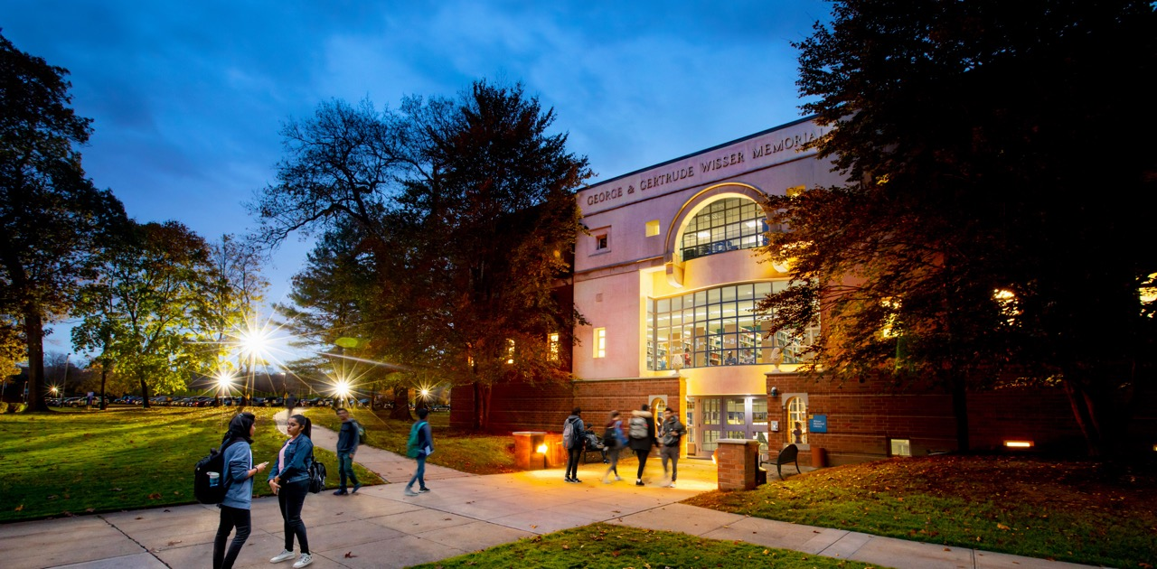
UMB Commercial Card
How-To Guide:
First-Time User Log-In and Setup
Notes:
Join our Facebook groups to connect with other admitted students and parents:
New York Tech Class of 2024
NYIT Parents

Slide 2
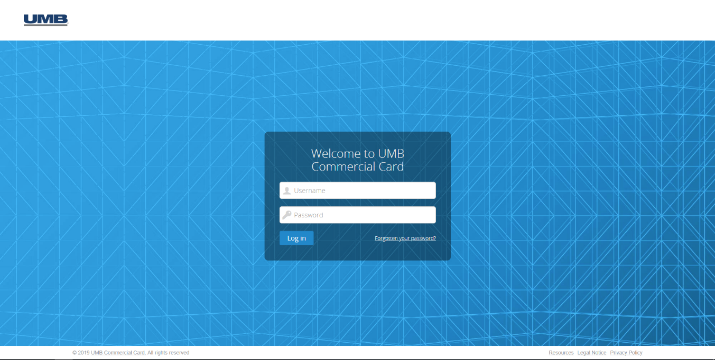
First-Time User Log-In and Set-Up
Link: https://identity.commercialcard.umb.com/login?signin=b2b896821f9468dec31091d42562631f#/login
Notes:
Join our Facebook groups to connect with other admitted students and parents:
New York Tech Class of 2024
NYIT Parents

Slide 3
First-Time Log-In: Enter User Name & Password
Username = your entire NYIT email address (i.e., john.smith@nyit.edu)
Password = Welcome1
Notes:
Join our Facebook groups to connect with other admitted students and parents:
New York Tech Class of 2024
NYIT Parents

Slide 4
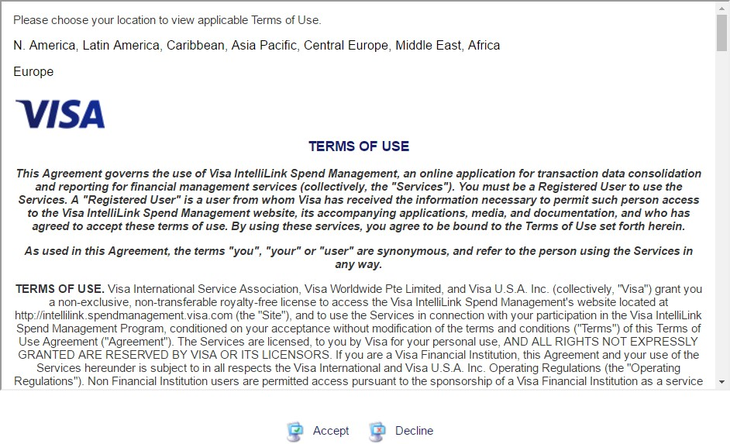
First-Time Log-In: Accept Terms of Use
Notes:
Join our Facebook groups to connect with other admitted students and parents:
New York Tech Class of 2024
NYIT Parents

Slide 5
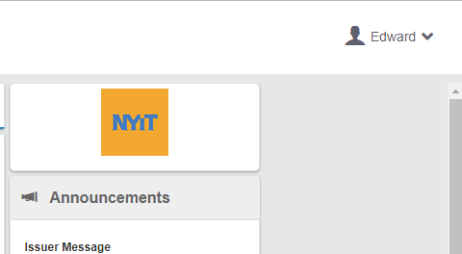

First-Time Log-In: Customize Views
From the Home Page, select pull—down arrow from the upper left-hand corner near your name:
Notes:
Join our Facebook groups to connect with other admitted students and parents:
New York Tech Class of 2024
NYIT Parents

Slide 6
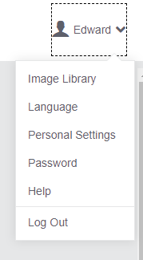
First-Time Log-In: Customize Views
Select “Personal Settings”
Notes:
Join our Facebook groups to connect with other admitted students and parents:
New York Tech Class of 2024
NYIT Parents

Slide 7
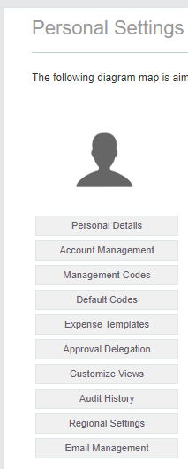
First-Time Log-In: Customize Views
Select “Customize Views”
Notes:
Join our Facebook groups to connect with other admitted students and parents:
New York Tech Class of 2024
NYIT Parents

Slide 8
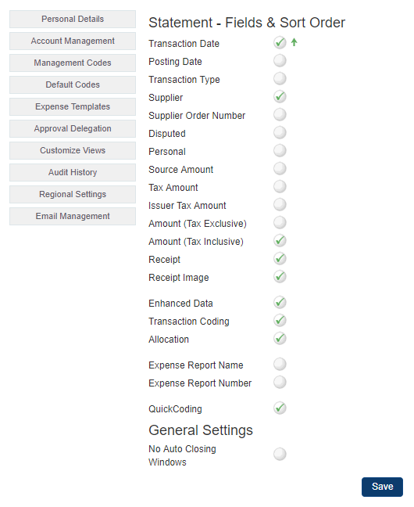
First-Time Log-In: Customize Views
Select the options indicated. Don’t forget to save!
Notes:
Join our Facebook groups to connect with other admitted students and parents:
New York Tech Class of 2024
NYIT Parents

Slide 9
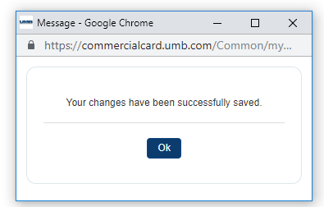
First-Time Log-In: Customize Views
The system will confirm the changes.
Notes:
Join our Facebook groups to connect with other admitted students and parents:
New York Tech Class of 2024
NYIT Parents

Slide 10
CONGRATULATIONS! You have successfully logged into UMB Commercial Card
Notes:
Join our Facebook groups to connect with other admitted students and parents:
New York Tech Class of 2024
NYIT Parents

