Slide 1
Couponing with Erin Part ii ☺
May 2019

Slide 2
Money Saving Apps
There’s always a way to save money!
Never pay full price for anything if you can help it!
Most stores and restaurants have reward cards/loyalty cards or email you coupons/savings. Sign up today!
Ibotta
Shopkick
Checkout 51
Groovebook
Whole Foods/Amazon Prime
Tanger Outlets
Hollar
Zulily
Krazy Coupon Lady
Ebates

Slide 3
IBOTTA APP

Slide 4
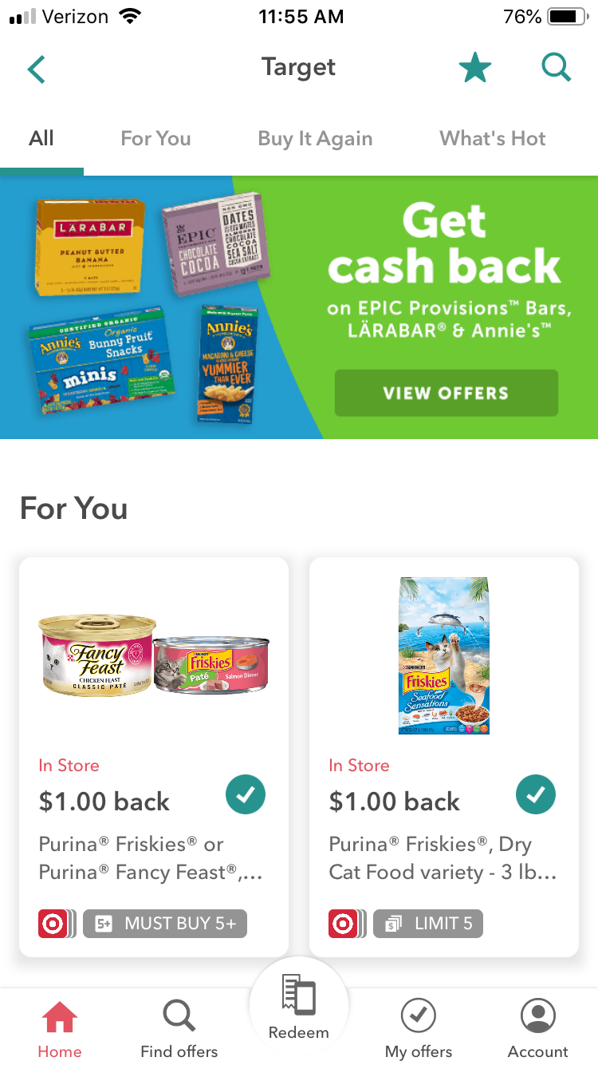
Target Cartwheel App and the Ibotta App
Can of fancy feast cat food .67 each
Buy 12 and get $1.00 cash back on Ibotta
Use the Target Cartwheel App and save an additional 20% off
And layer discounts by using your Target Red debit card and save an additional 5% off!!
12 cans of fancy feast 3 oz cans regular price = $8.04
SAVE w coupons = $2.01 savings and $1. cash back = you pay only $5.03! That’s over 30% savings!

Slide 5
Shopkick app
Shopkick is so cool! You earn “kicks” or points just by WALKING INTO a store!
Stores on Shopkick: TJ Maxx, Marshalls, Target, Walmart, Carters, Bed Bath and Beyond, Kohls, CVS, Best Buy, Home Goods, Yankee Candle and more
Earn kicks by walking into stores, scanning barcodes on selected items and/or purchasing the item(s) for additional kicks!
Once you reach 1,250 kicks, you can redeem it for a $5.00 gift card and 2.500 kicks can be redeemed for a $10.00 gift card that is emailed to you.

Slide 6
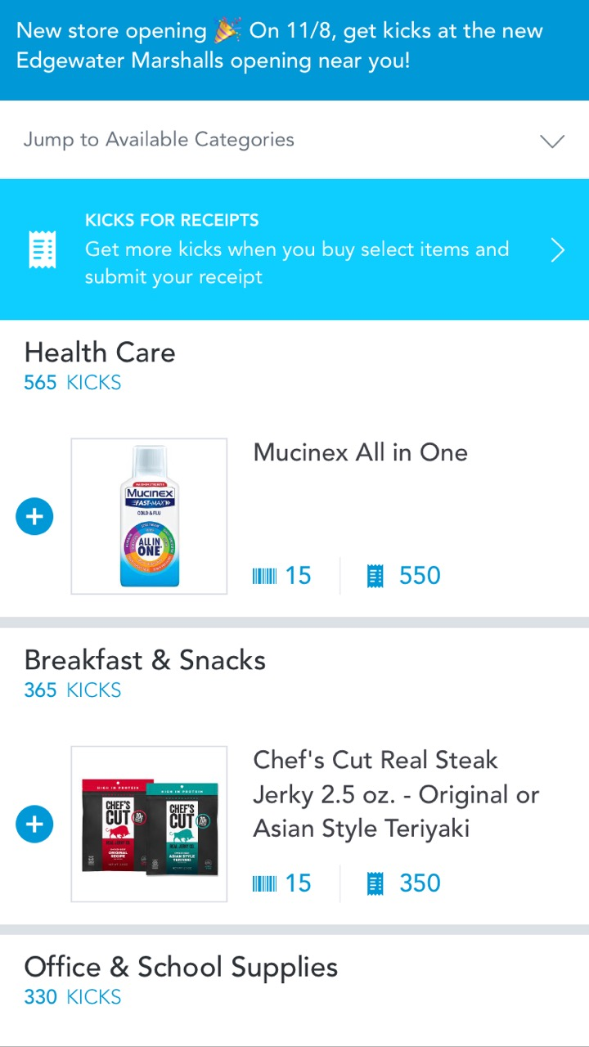
Shopkick

Slide 7
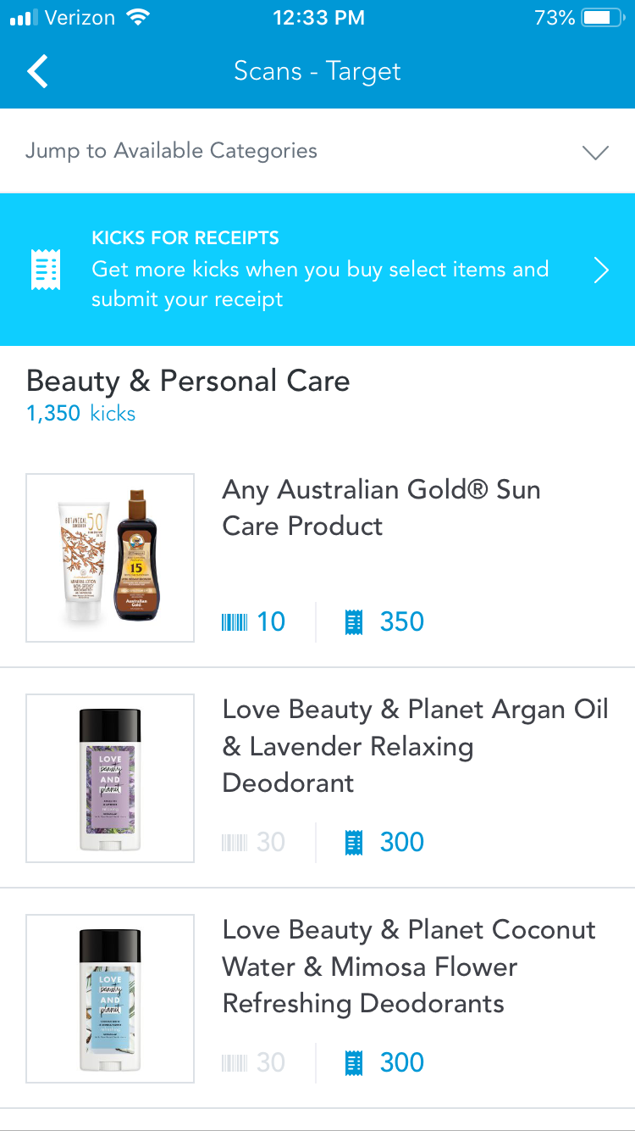
Shopkick review
Get kicks for walking in the door
Get more kicks for scanning barcodes on items
And if you purchase that item you get even more kicks!
Then link your debit or credit card to shopkick and get extra kicks!!!
And don’t forget to use cut coupons or digital coupons to save even more money ☺

Slide 8
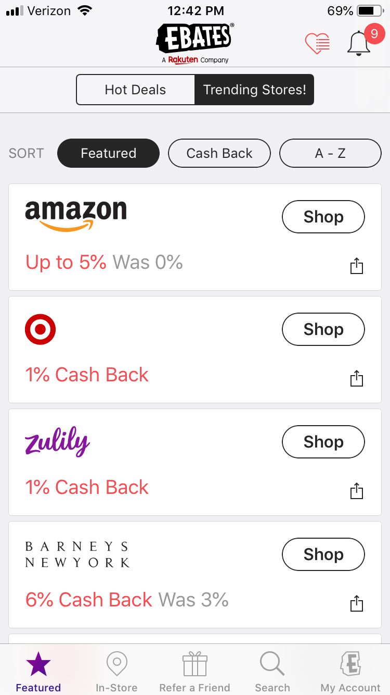
Ebates
If you shop on-line, then this is the app for you!
It now offers cash back IN stores too!

Slide 9
More money saving tips
https://www.mymoneycoach.ca/blog/budget-grocery-shopping-tips-to-save-money.html
Shop with a calculator and add things up as you put them in your cart. If you’re shopping with kids, give them the job of crossing off the item on the list or tallying up the cost.
Don’t automatically overlook no-name or store brands. Many are made by the brand name companies, just with a different label!
With OTC medications, go for the no-name brand! Compare active ingredients and save a ton of money! Even, shop at Dollar Tree for Tylenol, advil, etc. and save $$$
Why pay $10-12 for Advil when you can get 40 tablets of Ibruprofen (Advil) for $1. at Dollar Tree

Slide 10
Use coupons.com if you don’t get coupons mailed to you or don’t get the Sunday Newspaper
You can print coupons at home and bring to the store OR you can download the coupons.com app and get coupons right from you phone! Scan at the register

Slide 11
Other awesome apps to download and use
Tanger Outlets – for only $10. you can become a Tanger Outlet member for LIFE and receive a free $5.00 coupon booklet every singe day all year round
And, if you upload your receipts from Tanger outlet stores with your membership, they will give you free items and exclusive coupons when reach certain totals in sales!
Whole Foods has partnered with Amazon Prime – download the Whole Foods app and link it to your Amazon Prime for EXTRA savings on hundreds of products every week
Hollar is like an online Dollar Tree store and they offer FREE shipping when your order totals $25.00 or more! SO much fun and great gift ideas too

Slide 12
Groovebook
Groovebook is a subscription service that sends to you your mobile photos in a 4x6 photo book every month!
You select up to 100 photos from your phone that will be printed on perforated pages for easy removal.
It’s a great way to print, share and preserve your mobile photos month after month while saving your storage on your phone!
All this for only $3.99 plus tax each month!!

Slide 13
Do you go to Jiffy Lube?
Google Jiffy Lube coupons to ALWAYS find coupons for $13 off conventional oil change or $15 off synthetic oil change.
OR you can show them your NYIT faculty ID to always get 20% off your service!

Slide 14
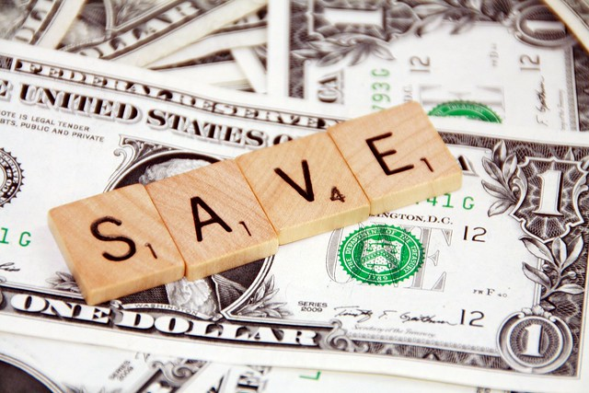
Discussion – what can you share?
What are some tips or advice you can share with us?
What are some of your favorite money saving apps that you use?

