Slide 1

PANEL 3: DIGITAL COMMUNICATIONS, AND SAFE, SMART CITIES
Moderator:
Babak D. Beheshti
Professor & Associate Dean,
School of Engineering & Computing Sciences, New York Institute of Technology
Old Westbury, NY, USA
Presenter and Date

Slide 2
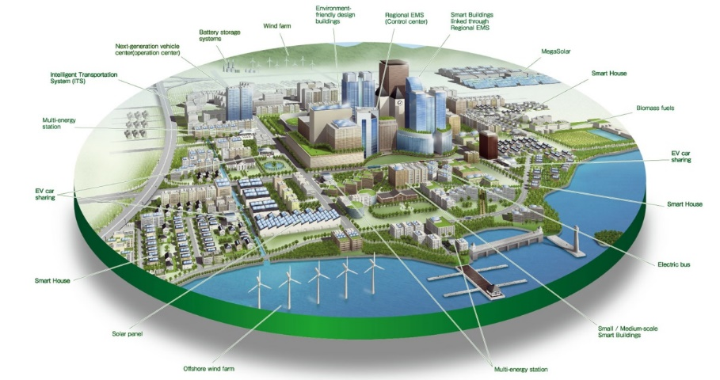
Smart cities are places where information technology is combined with infrastructure, architecture, everyday objects, and even our bodies to address social, economic, and environmental problems.
Anthony B. Townsend. (2014) Smart Cities, W.W.Norton & Company

Slide 3
Panelists
Xiaohui (Sean) CUI, Ph.D., Dean, International School of Software, Wuhan University
Jonathan VORIS, Ph.D., Asst. Professor, Computer Sciences, School of Engineering & Computing Sciences, NYIT
James WEN, Executive Technology Adviser, Chief Solution Architect, GCG Smarter City, IBM
Emile YIN, VP Strategy & Technology, Alcatel-Lucent Shanghai Bell.

Slide 4
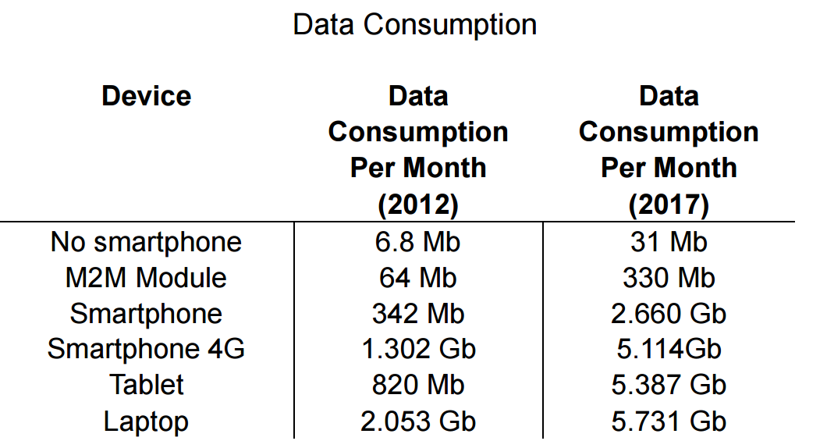
Facts
UN has predicted that the world´s urban population will grow by 75% by 2050
Cities occupy only 2% of planet, but account for 60- 80% of energy consumption
Barrionueovo, J., Berronne, P., and Ricart, J. Smart Cities,
Sustainable Progress. IESE Insight, Issue 14, 2002.
It is estimated that between 2012 and 2017, the growth in demand for data services will be 80% from a variety of end user device.
Report of data mobility 2013A by Cisco

Slide 5
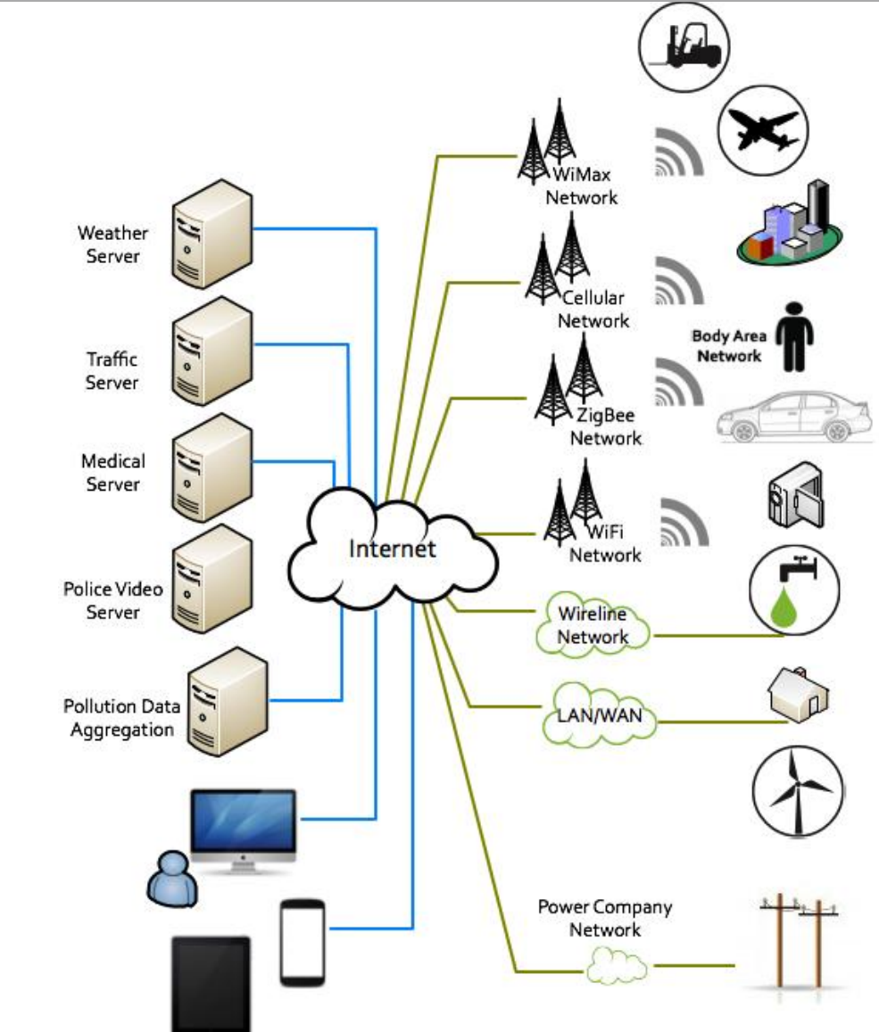
Digital Infrastructure of A
A Smart City
Source: A.D. Guerrero-pérez, A. Huerta, F. González And D. López, IEEE-CCD SMART CITIES WHITE PAPER, Network Architecture Based On Virtualized Networks For Smart Cities

Slide 6
Discussion
Challenges
Innovations
Best Practices
Model Cities

